Slide 1
haematocrit

Slide 2
The haematocrit (Ht or HCT)
American English spelling hematocrit
also known as Packed cell volume (PCV)
erythrocyte volume fraction (EVF).

Slide 3
PCV is the volume percentage of red blood cells in blood.
It is normally about 45% for men and 40% for women.
It is considered an integral part of a person ,s complete blood cell count, and platelet count, along with hemoglobin concentration, white blood cell count, and platelet count.

Slide 4
PCV can be determined by centrifuging heparinized blood in capillary tube (also known as a microhematocrit tube ) at 10,000 RPM for five minutes. This separates the blood into layers. The volume of packed red blood cells divided by the total volume of the blood sample gives the PCV. Because a tube is used, this can be calculated by measuring the lengths of the layers.

Slide 5
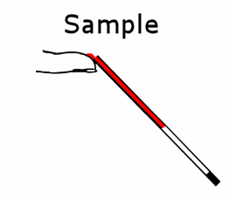
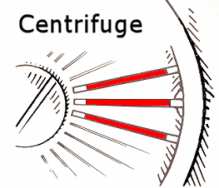
Measurement of Heamatocrit
Collect blood sample in heparinized capillary tube
Centrifuge
Read by haematocrit reading scale

Slide 6
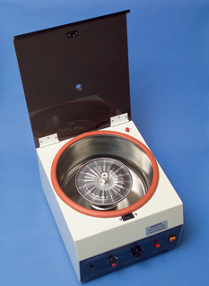
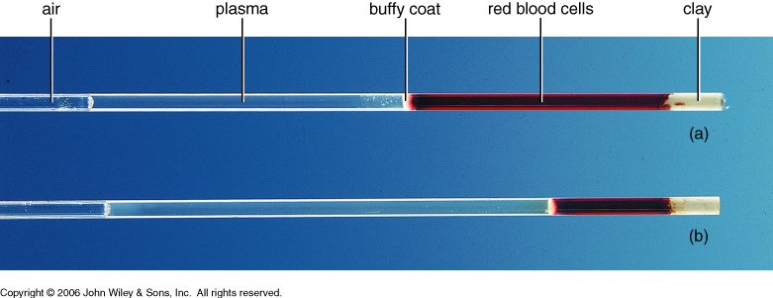
Hematocrit

Slide 7
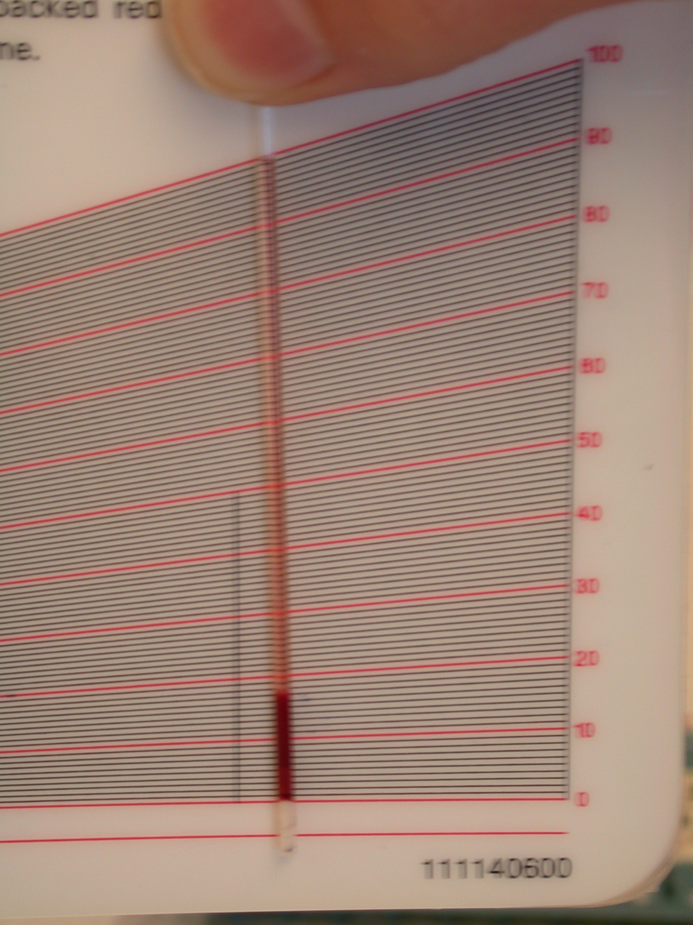
3
about 18%
4
2
1

Slide 8
Low hematocrit may be due to:
Anemia
Bleeding
Destruction of red blood cells
Leukemia
Malnutrition
Nutritional deficiencies of iron, folate, vitamin B12 and vitamin B6

Slide 9
High hematocrit may be due to:
Congenital heart disease
Cor pulmonale
Dehydration
Erythrocytosis
Low blood oxygen levels (hypoxia)
Pulmonary fibrosis
Polycythemia vera (genetic aberration)

